Slide 1
Active Sensing Shapes Sensory Feedback for Estimation and Control
Abhinav
Notes:
new

Slide 2
Active Sensing in Biological Systems
Control systems engineering – Independently design observers and controllers – Separation principle
Biological control systems – Use Active sensing – which violates requirements for seperability
Active sensing – Use the system’s own movements to alter sensory feedback.
Notes:
ndpa

Slide 3
Separation Principle
For linear systems, one can first design an optimal control u(x) assuming all the states x are available
Then design an observer x'(t) to estimation x(t)
Finally, use u(x'(t)) in implementation
The above ad-hoc implementation is not only sufficient but is also the optimal process for linear systems.

Slide 4
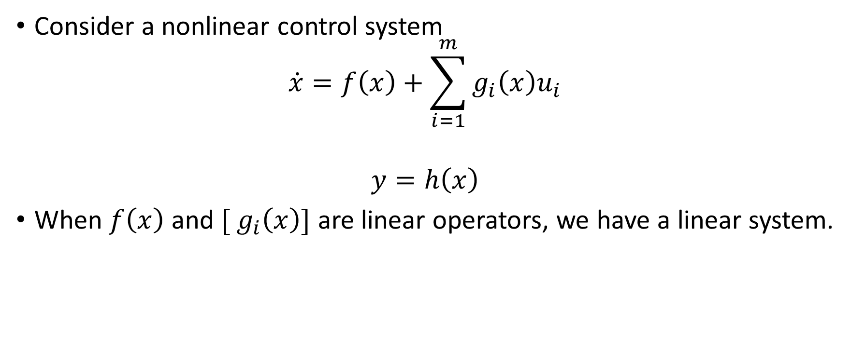
Nonlinear Observability
Consider a nonlinear control system
$$\dot{x}=f\left(x\right)+\sum_{i=1}^{m}{g_{i}\left(x\right)u_{i}}$$
$$y=h\left(x\right)$$
When $f\left(x\right)$ and ${[ g}_{i}\left(x\right)]$ are linear operators, we have a linear system.

Slide 5
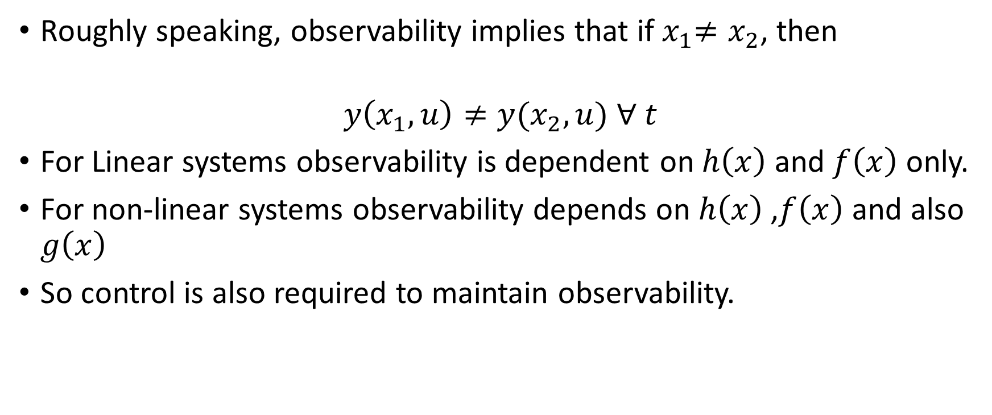
Nonlinear Observability
Roughly speaking, observability implies that if${ x}_{1}≠x_{2}$, then
$$y\left(x_{1},u\right)≠{y(x}_{2},u) ∀ t$$
For Linear systems observability is dependent on $h\left(x\right)$ and $f\left(x\right)$ only.
For non-linear systems observability depends on $h\left(x\right)$ ,$f\left(x\right)$ and also $g\left(x\right)$
So control is also required to maintain observability.

Slide 6
Need for Active Sensing
For nonlinear systems, the separation principle does not hold in general.
We have to treat sensing and control in an integrated fashion.
Active sensing and control

Slide 7
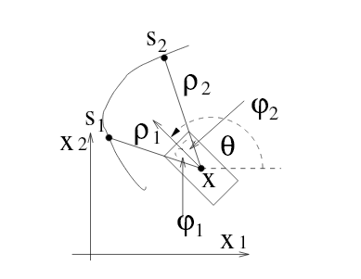
Existing Ideas
Non-linearity in dynamics + Limited linear sensors-> Active Sensing
Identify two different sub-manifolds which are partially observable
Control to orient the sub-manifolds to result in Observability
Xiaoming Hu and and T.Ersson , Active observers for nonlinear systems, Automatica vol 40 ,2004

Slide 8
Existing Ideas
Optimization with a measure of observability as another parameter
Measure of observability for LTI systems
Metrics for the Observability Gramian.
For Non Linear systems
Linearize around admissible trajectory and evaluate the Gramian metrics.

Slide 9
Electric Fish – Active sensing and Control
Weakly Electric Fish – Tracking a slow refugee in the dark.
Rapid “Whisking-like” forward and backward swimming movements.
High Frequency active movements are used to track the low-frequency movements of refugee.

Slide 10
Proposal
Apply control at higher “pumping frequency”. LTP system.
Now modulate the output and use a LPF
The Final output is now observable and can be controlled to track a goal point.

Slide 11
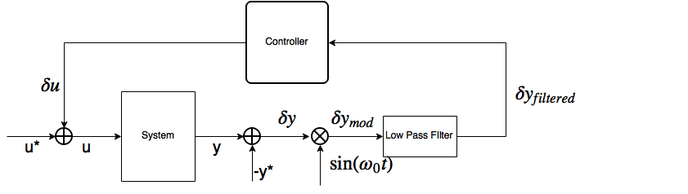
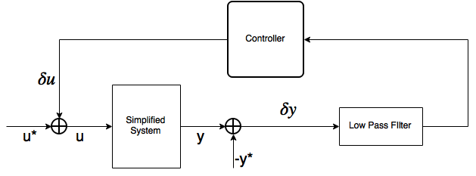
Idea

Slide 12

System
Simple 1 DOF System
$$\dot{x_{1}}=x_{2}$$
$$\dot{x_{2}}=−\frac{b}{m}x_{2}+\frac{1}{m}u$$
$$y=\frac{d}{dt}s\left(x_{1}\right)=s^{′}\left(x_{1}\right)x_{2}$$
Notes:
Sensor only measures the local rate of change of stimulus as the system moves relative to a sensory scene
X_1 position x_2 velocity mass is m and b is damping

Slide 13
Linear vs Non-Linear Observability
Linearization to give LTI system results in unobservable system
Where as the NLS is observable
So Linearize it to give a LTP system which can now be observable

Slide 14
Nonlinear to LTP – Use of HTF
Non-linear system Direct linearization gives rise to unobservable LTI system – Useless!
Now, we give the system an exciting control and linearize it around that equilibrium control to give rise to LTP system. – Which could be observable!
Notes:
Now, we give the system an exciting control and linearize it around that equilibrium control to give rise to LTP system. – Which could be observable!

Slide 15
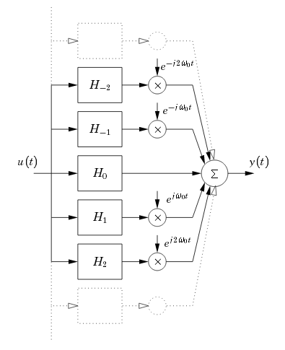

Simplifying LTP system - HTF
$y(t)=\sum_{k}{\left(h_{k}\left(t\right)∗u\left(t\right)\right)e^{jkω_{o}t}}$
Approximating the system of infinite LTI systems to just a series of three LTI systems gives
$y=h_{0}∗u+\left(h_{1}∗u\right)e^{jω_{0}t}+\left(h_{−1}∗u\right)e^{−jω_{0}t}$

Slide 16
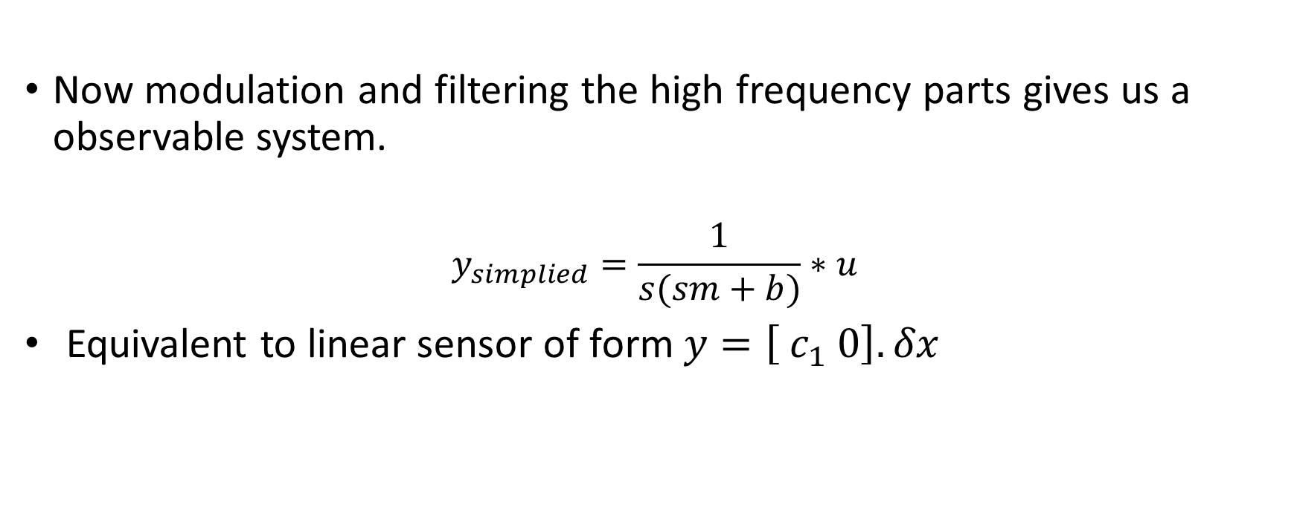
LPF and final Observable system
Now modulation and filtering the high frequency parts gives us a observable system.
$$y_{simplied}=\frac{1}{s(sm+b)}∗u$$
Equivalent to linear sensor of form $y=\left[ c_{1} 0\right].δx$
Observable

Slide 17
Final System Representation

Slide 18
Results
Observability guaranteed with just one sensor for any scene.
The Observability Gramian is now always full rank.
This output can now be fed through a LQG controller to successfully control the system

Slide 19
Results – Equivalence of the simplified LTI system and overall nonlinear stuff

Slide 20
Results – Successful trajectory tracking using the LQG controller

Slide 21
Further Work
Kernel Based observing of sensory scenes
Visual servoing
How the observable manifolds in LTI,LTP and Non-Linear are related to each other -> resulting in observability or loss thereof

Slide 22
Thank You

